Slide 1


Slide 2
Mrs. Coleman
7th Grade: Vocabulary and English
8th Grade: Reading and English
Team Teaching Art with Mr. Capraro

Slide 3
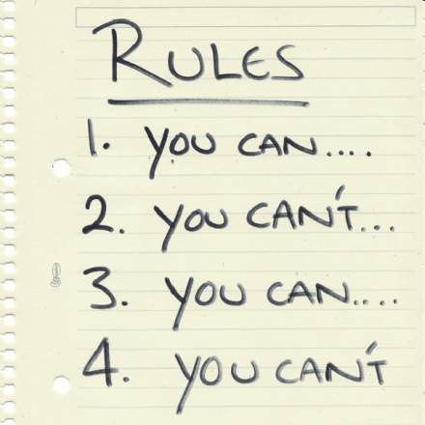
Rules
No late class work or homework will be accepted! If there are extenuating circumstances, then half credit will be given if a signed parent excuse is stapled to the work. incomplete for that assignment.
No more than one late assignment per trimester per subject will be accepted without a parent teacher conference.

Slide 4

Rules continued
Turning in projects late will result in a deduction of the overall project grade per day.
If you have not done your homework, and choose to do it in class, you will receive an incomplete for that assignment.

Slide 5
Absent work
For information on absent work please refer to the handbook. Note that tests will be given on the day a student returns to school.
Approximately one-week notice is given before tests; therefore students should use their time wisely and study in advance for tests in case of illness or unforeseen circumstances.

Slide 6

The Basics Work Best
• Extra credit does not exist for these classes. Do your work consistently, neatly, and with pride. You will not need nor want extra credit.
• No name, no credit! No full heading, no full credit! Not legible, no credit!

Slide 7
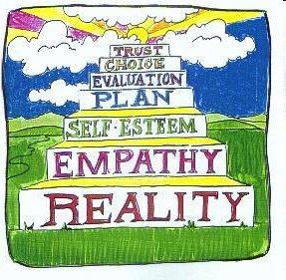
Respect Others
Respect all people, ideas, and property, including textbooks. If you lose, alter or destroy any textbooks you will be charged for them so they can be replaced.

Slide 8

Responsibility
You must show responsibility for your own behavior, learning, and work habits.

Slide 9
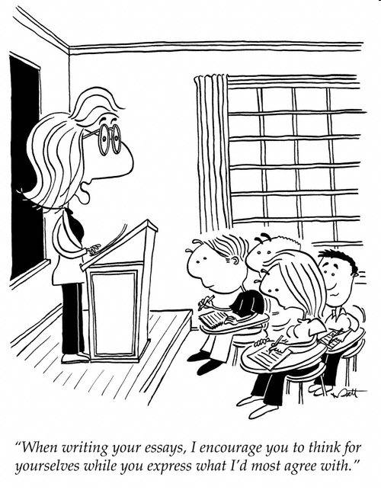
Standards Based Curriculum with an integration of the common core standards
Two writing projects per trimester will be required.
Students may be required to complete some aspects of projects in class and while the final project is the goal, the process is just as important. If you choose not to participate, it will reflect upon the overall grades.

Slide 10
The Writing Projects for 7th Grade
Response to Literature (Writing Standard 7.2.2)
Fictional Autobiographical Narrative
(Writing Standard 7.2.1)
Research Report (Writing Standard 7.2.3)
Persuasive Composition
(Writing Standard 7.2.4)
Summary
(Writing Standard 7.2.5)
How to Essay
(Writing Standard (8.2.6)

Slide 11
7th Grade Vocabulary
Additionally, students will understand the most important points in the history of English language and use common word origins to determine the historical influences on English word meanings. Consequently, standard weekly homework and quizzes will be given. Tests will be taken weekly with cumulative review projects every three lessons.
Curriculum focuses on word origin to better prepare students for high school entrance exams and an overall knowledge of the English language, which will benefit the students in the future.

Slide 12
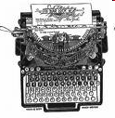
8th Grade Writing
Projects
Biography
(Writing Standard 8.2.1)
Job Resume with Business Letter and Technical Document
(Writing 8.2.5 and 8.2.4)
Research Report
(Writing Standard 8.2.3)
Persuasive Editorial (Writing Standard 8.2.4 and 8.2.2)
Four year contract (Writing Standard 8.2.6)

Slide 13

7th and 8th Grammar
Curriculum
We will also include grammar within the school year curriculum, which will focus on parts of speech, sentence structure, and punctuation.
Assessments will follow the end of each chapter.

Slide 14

Daily Writing Practice & Daily Language Practice
Students will write and practice grammar-editing regularly (D.W.P./D.L.P.) to improve skills focusing on sentence, paragraph, and essay structures.
It is important students have a notebook throughout the year so you can monitor progress.

Slide 15

Reading. . .
I suggest that while there is required reading for these classes, please do not limit your reading to what is assigned.
Any reading that you do can only increase reading comprehension skills, which in turn will help your test taking skills in any area of academics.

Slide 16
Art
We will focus on artists, their techniques and interpretations of the art itself as well as fun crafts that integrate art.
Grades will be based upon progress and overall final project.

